Slide 1
Template Metaprogramming
// By Sven van Huessen

Slide 2
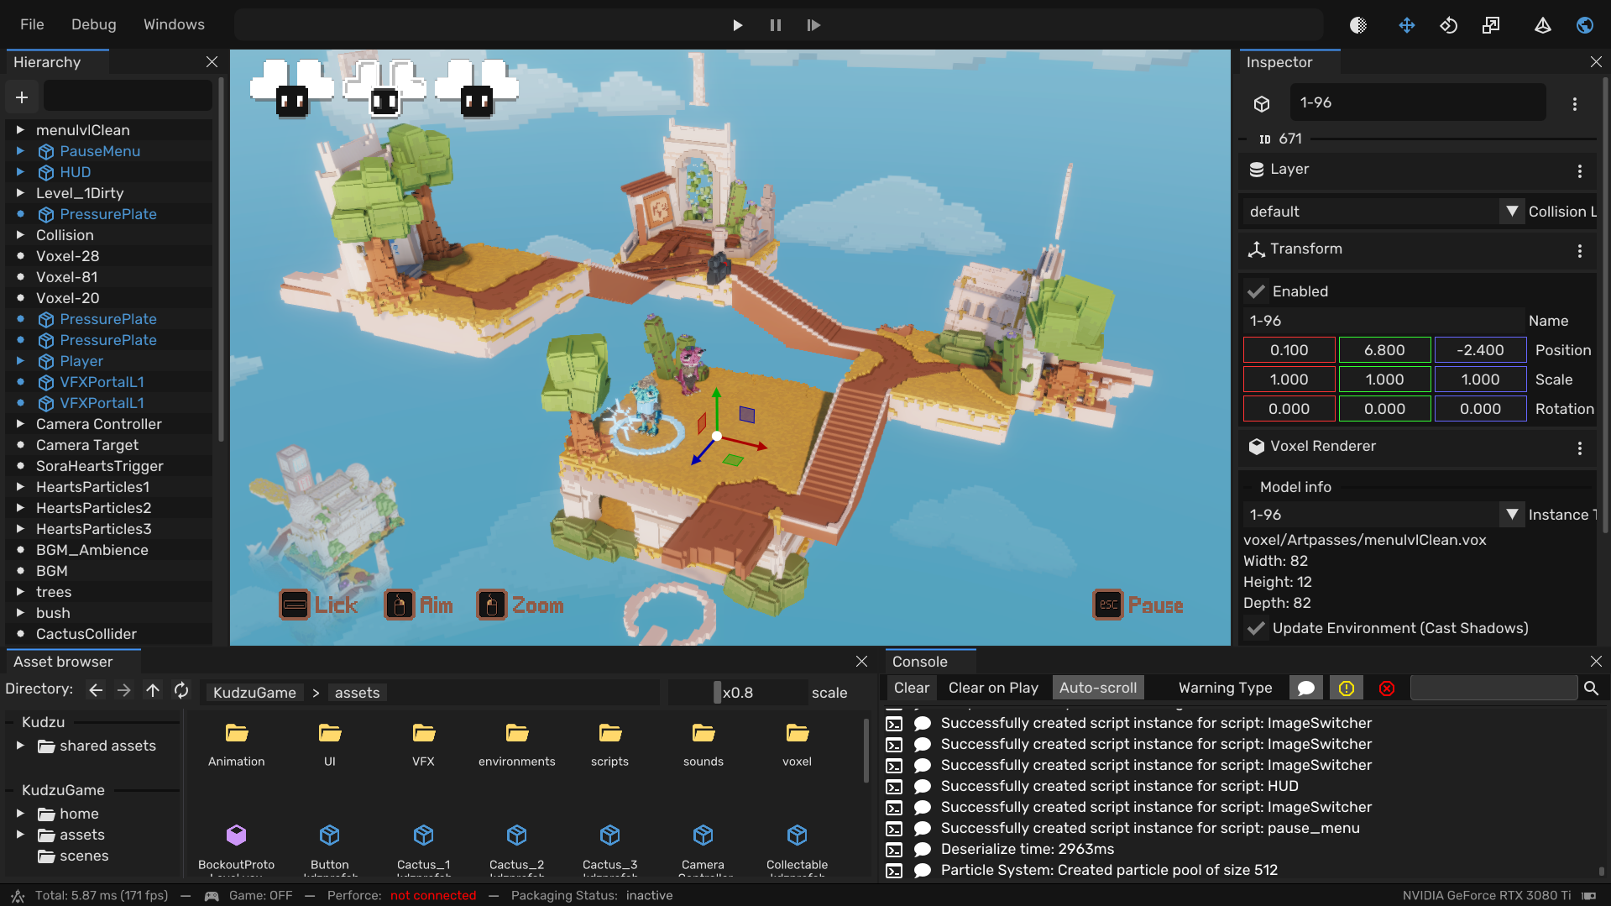

Who am I?
Worked on Kudzu, voxel engine
Engine Architecture
Editor
Serialization
Prefabs
Scripting
ImReflect – reflection based ImGui wrapper
Sven-vh/ImReflect

Slide 3
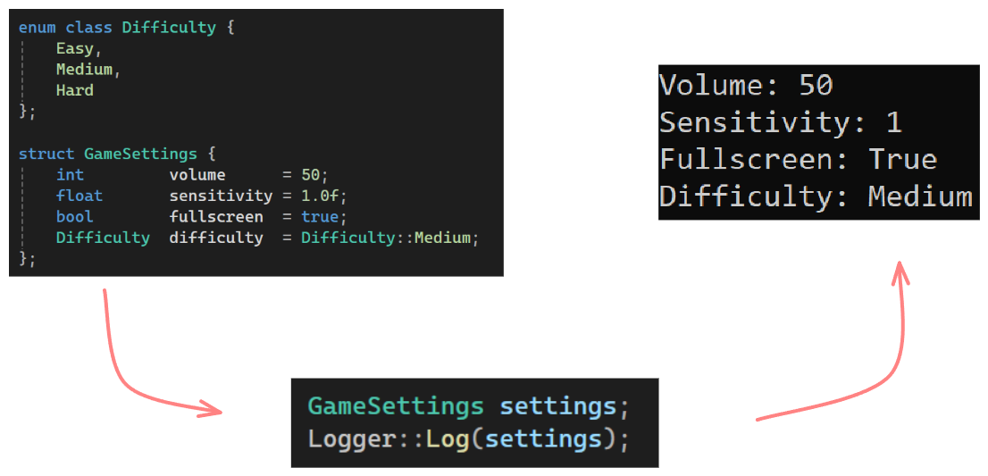
Goal
- What I wish I knew
- Logger
- Single Entry Point
- DRY principle
// “DRY - Don’t Repeat yourself”

Slide 4
Topics
- Function overloading
Templates
SFINAE
- Reflection
Use cases
- Future

Slide 5
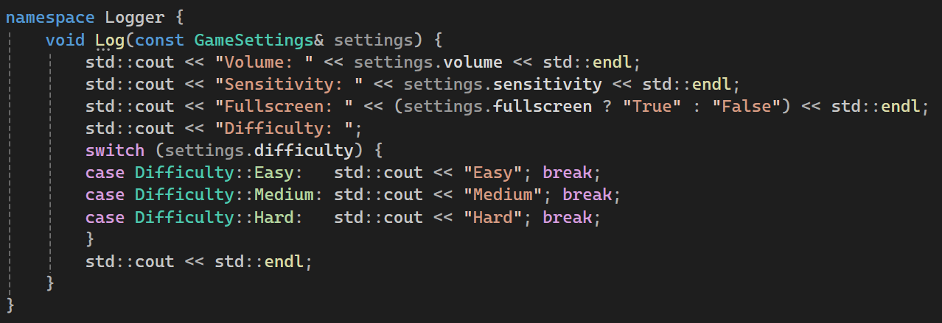
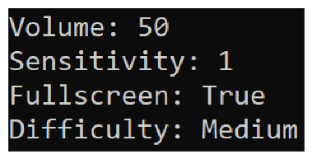
Most Intuitive
It works
But…
Lots of work
Not scalable
- Fragile

Slide 6
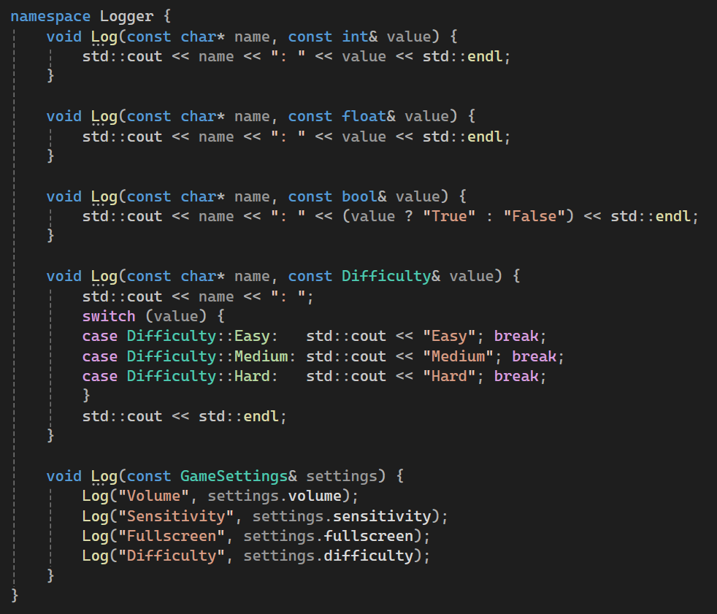
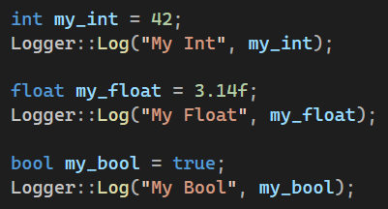
Operator Overloading
Single-Purpose
Reusable
Compiler will figure out
But…
Fragile (GameSettings & Difficulty)
Repetition (int & float)

Slide 7
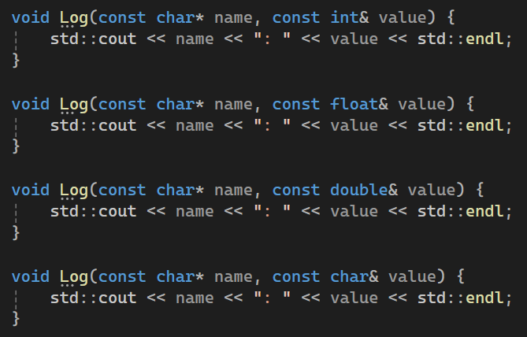
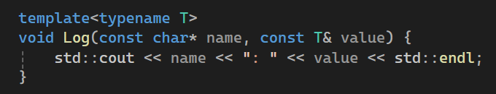
Templates
Generic
Typename T can be anything
Compiler is smart
// Into

Slide 8
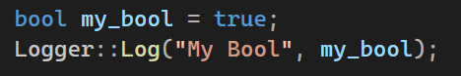
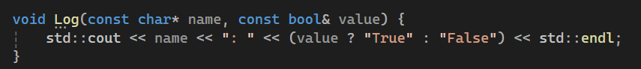
Question
What happens When you call the Log function with a bool?
Uses templated function
Uses specilization function
Throws Error C2668, “ambiguous call to overloaded function”

Slide 9
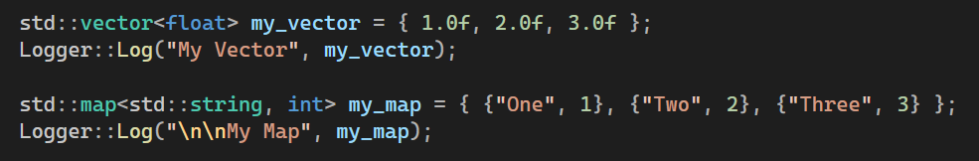
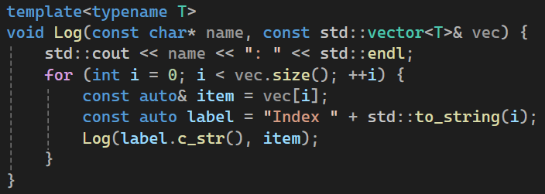
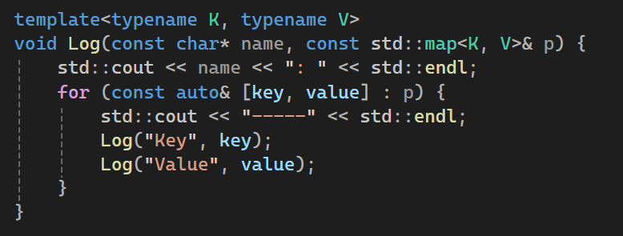
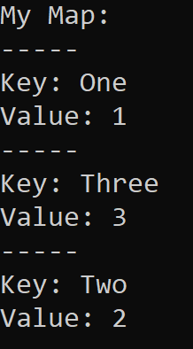
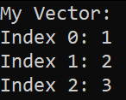
Templates
Used for much more

Slide 10
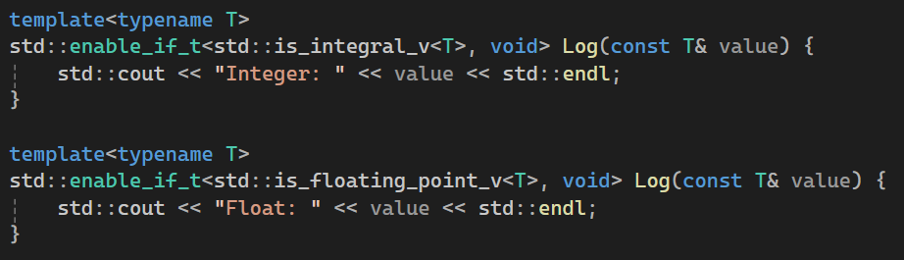
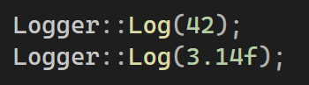
Extra: SFINAE “Substitution Failure Is Not An Error”
Customizations
// Prints: “Integer: 42”
// Prints: “Float: 3.14”
std::enable_if_t<condition, return type>

Slide 11
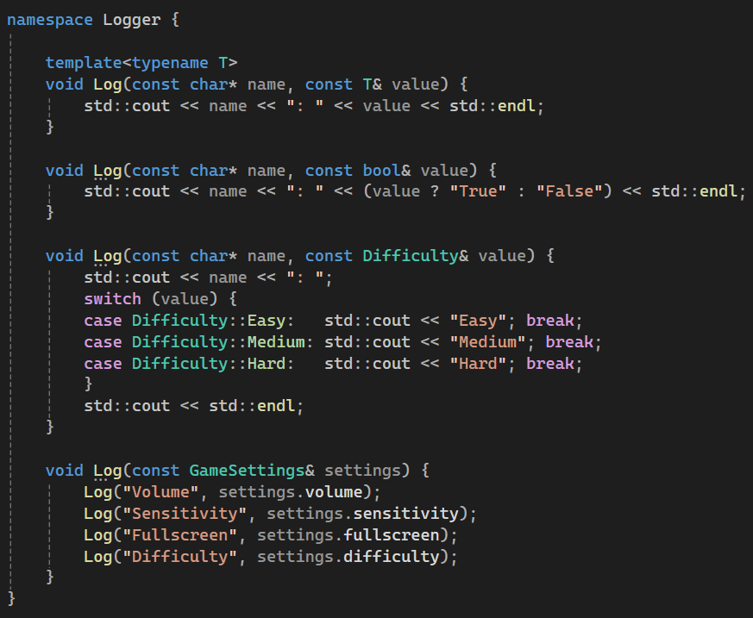
What now…
We have:
Single Entry Point
Basic types
Problem:
- Manual work
- Fragile

Slide 12
Reflection
Aspect | Compile time | Runtime
Speed | ✅Zero Overhead | ❌Lookups & dynamic casting
Memory | ✅No metadata | ❌Type metadata
Compile times | ❌Slower | ✅Faster
Debugging | ❌Difficult | ✅Easier
Errors | ❌Cryptic | ✅Clear
Learning Curve | ❌Difficult | ✅Easier
Safety | ✅Compile time | ❌Runtime
Code | ✅Reusable | ❌Manual
Examine types
Loop though members
Type info, name, value
Java, C#, Python built-int
Compile vs. runtime
entt::meta = runtime
Visit_struct = compile time

Slide 13
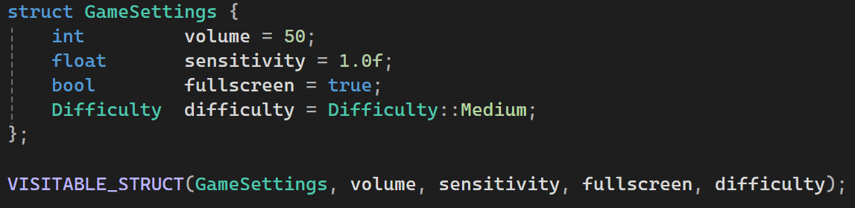
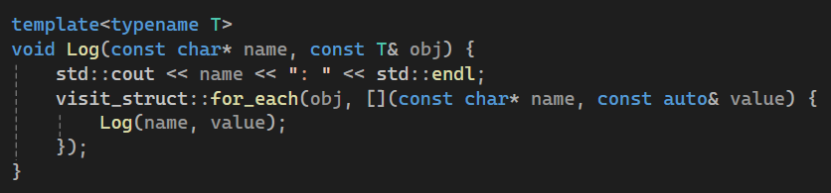
Reflection visit_struct
Define macro
Make a function
Loop through members

Slide 14
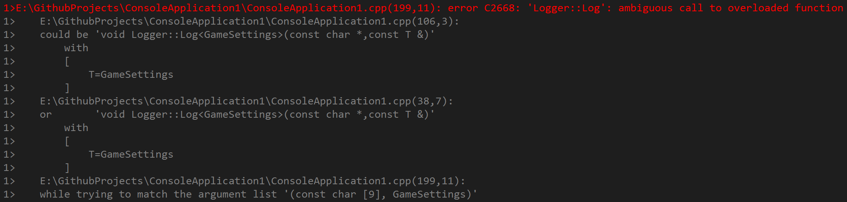
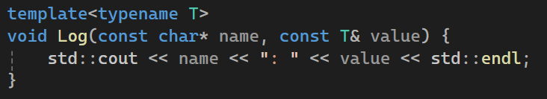
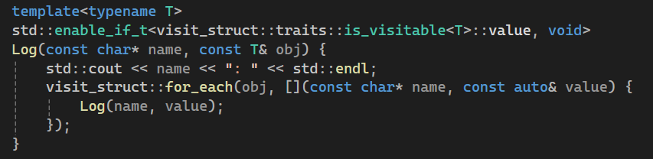
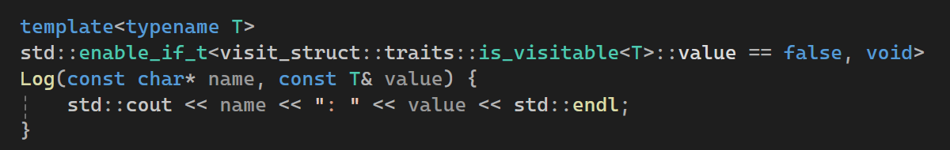
Reflection visit_struct
Except…
Problem:
Solution
Add SFINAE

Slide 15
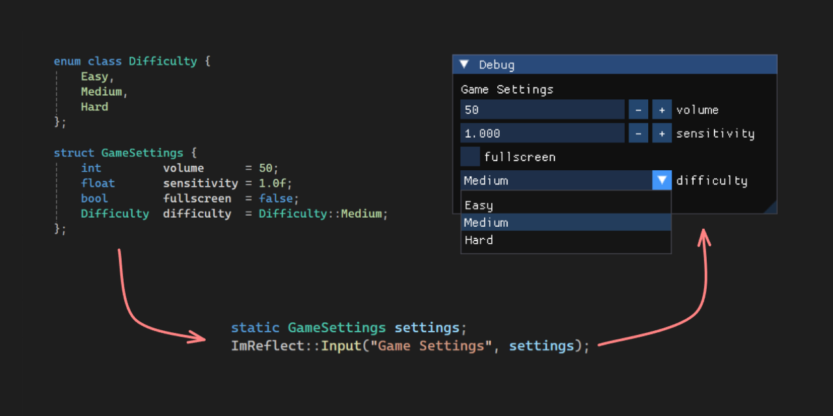
Use Cases / Future
Logger
Serialization
Deserialization
Editor Inspector
Scripting Registration
CPP 26
Built in reflection
No more external libraries

Slide 16
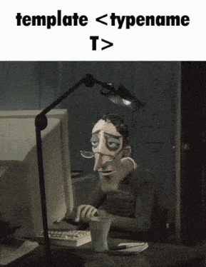



That’s it
Happy meta programming!
Feel free to ask me anything
All sample code on GitHub
linkedin/in/sven-van-huessen
github.com/Sven-vh/reflection-presentation

